Slide 1


Dishcover
An exhibition Management System
Jesper Riemer Andersen
Sam Sepstrup Olesen
Simon Reedtz Olesen
Jacob Karstensten Wortmann
Nicklas Andersen

Slide 2
Analysis
Sam Sepstrup Olesen

Slide 3
Motivation
Other solutions does not satisfy our needs
Increasing number of mobile devices
A digital cookbook might provide more functionality
Search
Filtering
Suggestions
3 OF 32 | 15.02.2014
Department of computer science
AALBORG UNIVERSITy

Slide 4
Existing Solutions
Extract the best practices of each application
Supercook
Allthecooks
BigOven
4 OF 32 | 15.02.2014
Department of computer science
AALBORG UNIVERSITy

Slide 5
Supercook
Web application
Has a set of unique features
Word cloud
Search recipes by ingredients
Improvements
Better ordering of recipes
5 OF 32 | 15.02.2014
Department of computer science
AALBORG UNIVERSITy

Slide 6
Allthecooks
Android application
Pros
Beautiful design
Filtering search results
Favourite and shopping list
Cons
Have not implemented search by ingredients
6 OF 32 | 15.02.2014
Department of computer science
AALBORG UNIVERSITy

Slide 7
BigOven
Android application
Pros
Menu-cards
Simple search by ingredients
Favourite and shopping list
Cons
Design and structure is cluttered
Hard to find the wanted functionality
7 OF 32 | 15.02.2014
Department of computer science
AALBORG UNIVERSITy

Slide 8
Problem Statement
Easy to search the Internet for new recipes
App where the user can discover new recipes
“How can we take advantage of the mobile platform, in order to provide the user with relevant recipes based one specific ingredients, and taking any user defined restrictions, like allergies, into consideration.”
8 OF 32 | 15.02.2014
Department of computer science
AALBORG UNIVERSITy

Slide 9
Requirements
Android
Search by ingredients
Free-test search
Search filters
Favourite recipes
Shopping List
Sharing
Persistency
Unit Conversion
Additional Languages
No login required
9 OF 32 | 15.02.2014
Department of computer science
AALBORG UNIVERSITy

Slide 10
Design
Nicklas Andersen

Slide 11
Architecture
11 OF 32 | 15.02.2014
Department of computer science
AALBORG UNIVERSITy

Slide 12
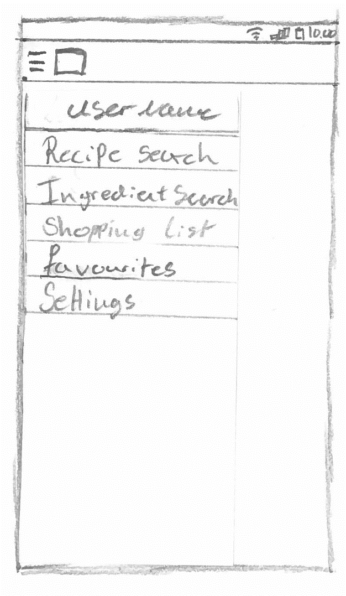
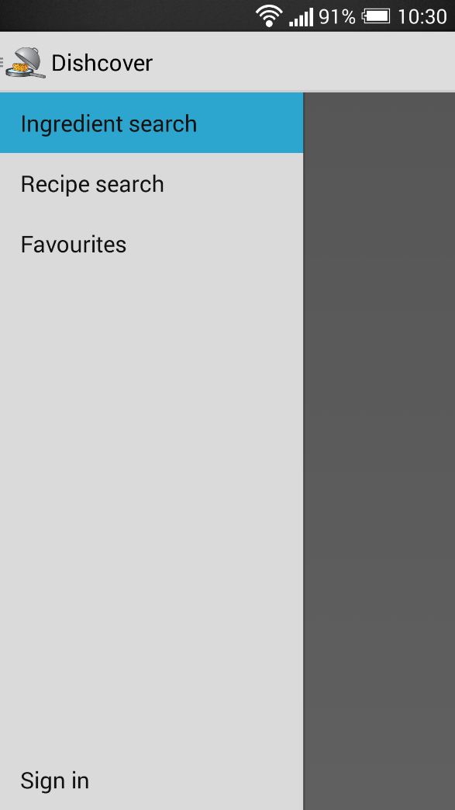
Navigation drawer
9 OF 32 | 15.02.2014
Department of computer science
AALBORG UNIVERSITy

Slide 13
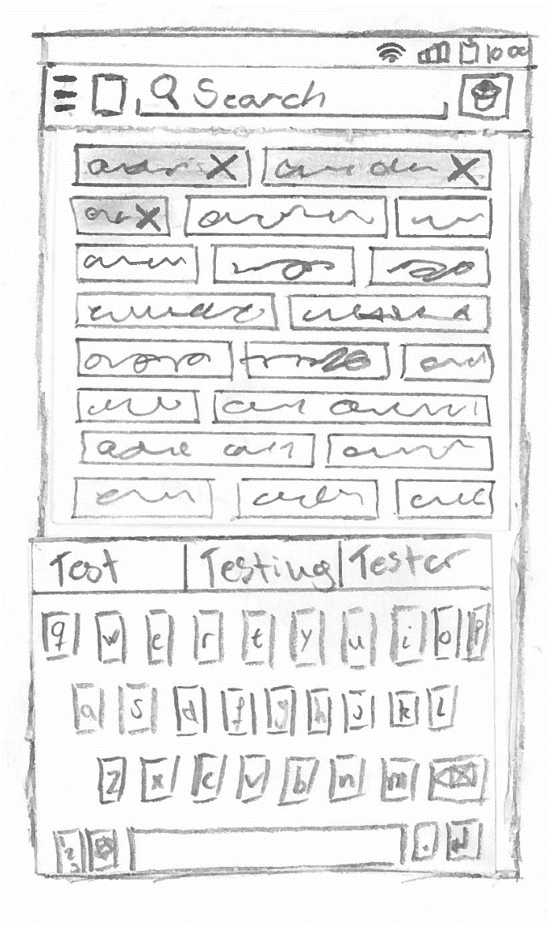
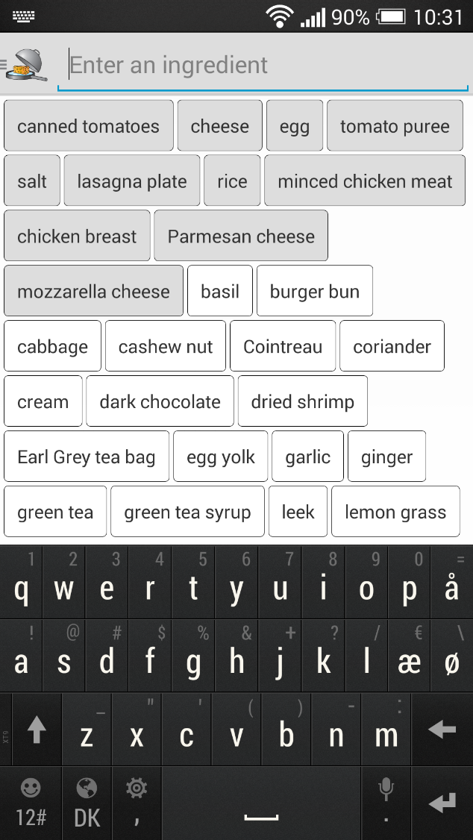
Ingredient search
10 OF 32 | 15.02.2014
Department of computer science
AALBORG UNIVERSITy

Slide 14
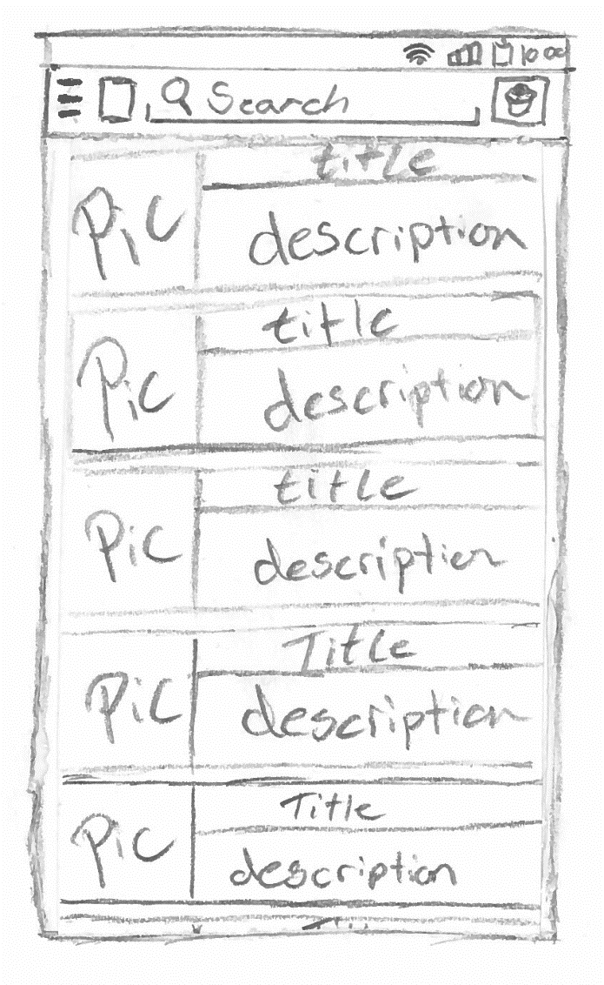
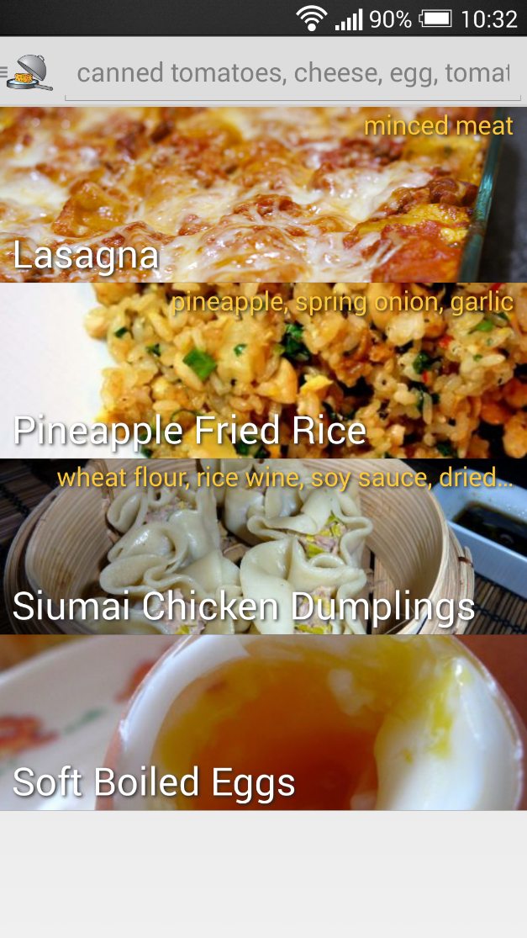
Result list
11 OF 32 | 15.02.2014
Department of computer science
AALBORG UNIVERSITy

Slide 15
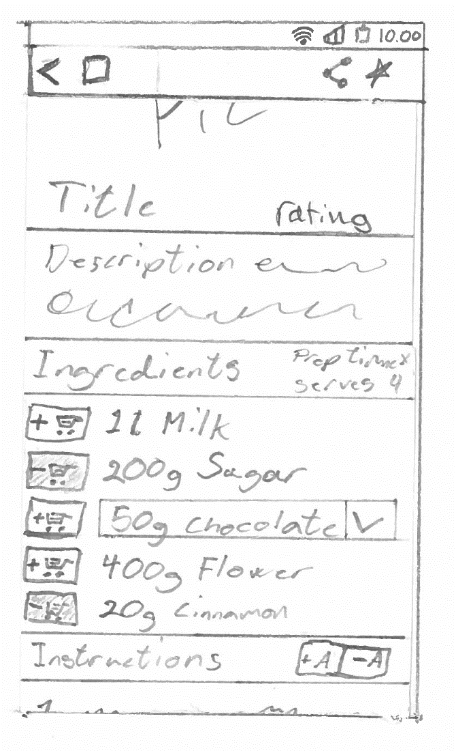
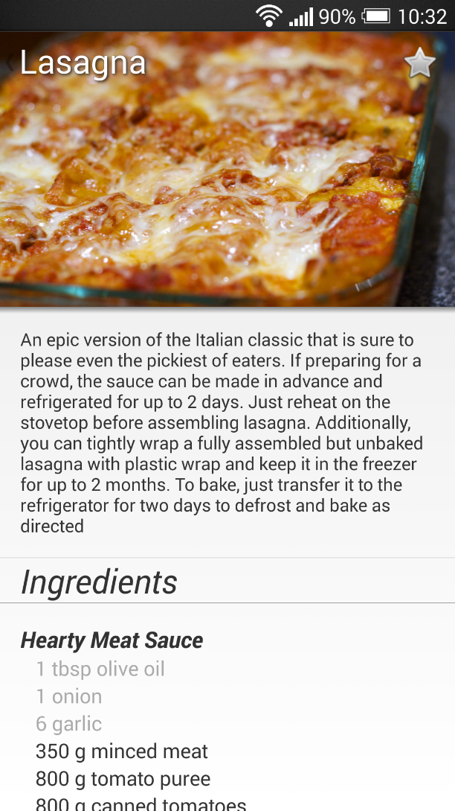
Recipe
12 OF 32 | 15.02.2014
Department of computer science
AALBORG UNIVERSITy

Slide 16

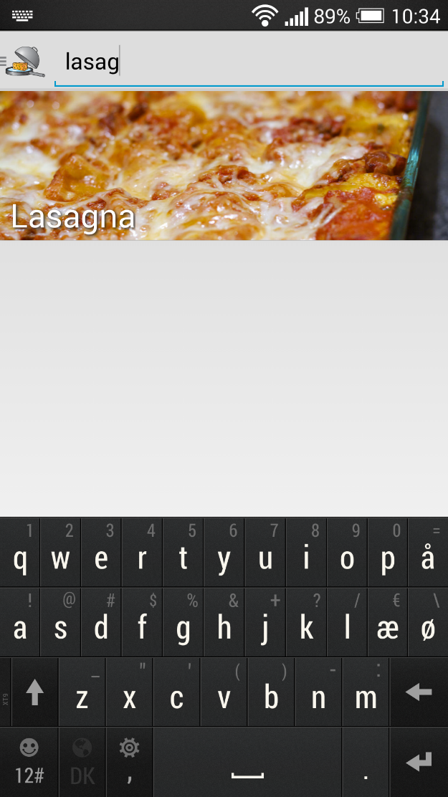
Test search
13 OF 32 | 15.02.2014
Department of computer science
AALBORG UNIVERSITy

Slide 17
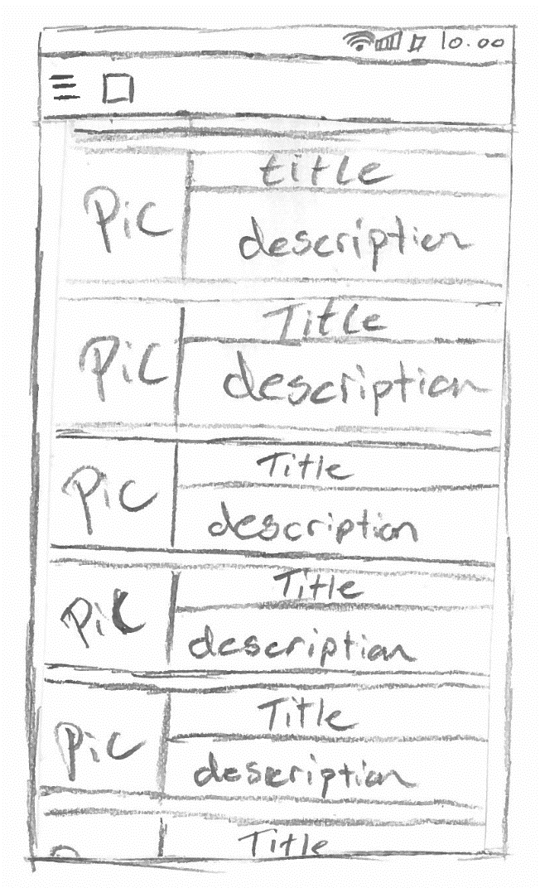
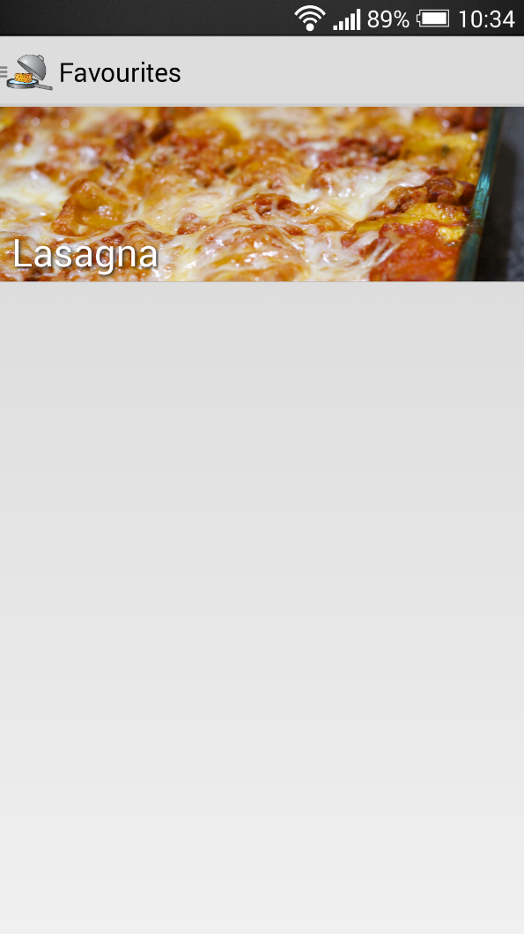
Favourites
14 OF 32 | 15.02.2014
Department of computer science
AALBORG UNIVERSITy

Slide 18
Hest
Simon Reedtz Olesen

Slide 19
Social Media
Social media sign-ins
We use sign-in to identify the user
Remove the security measures
We use Google+
19 OF 32 | 15.02.2014
Department of computer science
AALBORG UNIVERSITy

Slide 20
Server Api
To get the status a recipe we use the following URI:
Http://figz.Dk/food/lib/favourites.Php? Action=status& recipeid=4& hash=d74df7a0c28526d5c811465046e455f33c0b3db5989c533c5b4576e2900e36c4& limit=10& offset=0
Hash is the user’s email hashed.
20 OF 32 | 15.02.2014
Department of computer science
AALBORG UNIVERSITy

Slide 21
Server Api
The server receives the client call
Action is “status”
The method Favouritestatus($recipeid, $hash) is called
Finds/creates the user(hash) in the database
Tries find the recipeid in the user’s list of favourites
Returns the result
21 OF 32 | 15.02.2014
Department of computer science
AALBORG UNIVERSITy

Slide 22
Model Component
the model resembles the
relational database
22 OF 32 | 15.02.2014
Department of computer science
AALBORG UNIVERSITy

Slide 23
Model Component
the model resembles the
relational database
23 OF 32 | 15.02.2014
Department of computer science
AALBORG UNIVERSITy

Slide 24
Entity-Relationship Diagram
24 OF 32 | 15.02.2014
Department of computer science
AALBORG UNIVERSITy

Slide 25
Search by ingredients
Jesper Riemer Andersen

Slide 26
Search by ingredients
Precedence function
Remove recipes without any matching ingredients.
Sort by least missing optional ingredients.
Sort by most matching optional ingredients.
Sort by least missing mandatory ingredients.
Sort by most matching mandatory ingredients.
6 OF 32 | 15.02.2014
Department of computer science
AALBORG UNIVERSITy
Notes:
- So to show our application we decided to create an exhibition.
Firstly the organiser create the floor plan with our website tool, and while also doing creating data for the android application.
- When the exhibition is ready, users can scan a sepcial NFC tag to enter the exhibition.
- The user can subscribe to different booths to gain relavant information. The users receives information by feeds, the feeds are
created by booths. The users only receives feeds from booths they are subscribed to.
- The user can also see a schedule of the exhibition, that are sceduled ahead of time, this could be presentation of a new
product.
- With the help of the floor plan the user can also navigate to different booths, he uses the NFC tags to tell the application about
his current location.

Slide 27
Matching ingredients
Calculate how many of the user specified ingredients exists in each recipe.
Find all quantities that contains an ingredient specified by the user. $quantityQuery
Check Whether each quantity appear as a part of a mandatory and/or an optional exchangeable. $ingredientQuery
Count the number of distinct matching mandatory and optional ingredients for each recipe. $matchingQuery
6 OF 32 | 15.02.2014
Department of computer science
AALBORG UNIVERSITy
Notes:
- So to show our application we decided to create an exhibition.
Firstly the organiser create the floor plan with our website tool, and while also doing creating data for the android application.
- When the exhibition is ready, users can scan a sepcial NFC tag to enter the exhibition.
- The user can subscribe to different booths to gain relavant information. The users receives information by feeds, the feeds are
created by booths. The users only receives feeds from booths they are subscribed to.
- The user can also see a schedule of the exhibition, that are sceduled ahead of time, this could be presentation of a new
product.
- With the help of the floor plan the user can also navigate to different booths, he uses the NFC tags to tell the application about
his current location.

Slide 28
Missing ingredients
Calculate how many not covered exchangeables exists in each recipe.
$lackingQuery
Find all exchangeables that does not contain an ingredient specified by the user or an ignored ingredient.
Count the number of mandatory and optional exhangeables for each recipe.
6 OF 32 | 15.02.2014
Department of computer science
AALBORG UNIVERSITy
Notes:
- So to show our application we decided to create an exhibition.
Firstly the organiser create the floor plan with our website tool, and while also doing creating data for the android application.
- When the exhibition is ready, users can scan a sepcial NFC tag to enter the exhibition.
- The user can subscribe to different booths to gain relavant information. The users receives information by feeds, the feeds are
created by booths. The users only receives feeds from booths they are subscribed to.
- The user can also see a schedule of the exhibition, that are sceduled ahead of time, this could be presentation of a new
product.
- With the help of the floor plan the user can also navigate to different booths, he uses the NFC tags to tell the application about
his current location.

Slide 29
Sort result
Order the result according to the precedence function.
$sortingQuery
Recipe | Mandatory matching | Mandatory missing | Optional matching | Optional missing
Boiled egg | 1 | 0 | 0 | 0
Cookies | 4 | 1 | 0 | 3
Ice cream | 2 | 3 | 1 | 1
Bread | 4 | 3 | 1 | 2
Recipe | Mandatory matching | Mandatory missing | Optional matching | Optional missing
Cookies | 4 | 1 | 0 | 3
Bread | 4 | 3 | 1 | 2
Ice cream | 2 | 3 | 1 | 1
Boiled egg | 1 | 0 | 0 | 0
6 OF 32 | 15.02.2014
Department of computer science
AALBORG UNIVERSITy
Notes:
- So to show our application we decided to create an exhibition.
Firstly the organiser create the floor plan with our website tool, and while also doing creating data for the android application.
- When the exhibition is ready, users can scan a sepcial NFC tag to enter the exhibition.
- The user can subscribe to different booths to gain relavant information. The users receives information by feeds, the feeds are
created by booths. The users only receives feeds from booths they are subscribed to.
- The user can also see a schedule of the exhibition, that are sceduled ahead of time, this could be presentation of a new
product.
- With the help of the floor plan the user can also navigate to different booths, he uses the NFC tags to tell the application about
his current location.

Slide 30
Test
Jacob Karstensen Wortmann

Slide 31
Black-Box
Test Cases
Procedures
Success Criteria
Case Results
Shopping List not implemented
31 OF 32 | 15.02.2014
Department of computer science
AALBORG UNIVERSITy

Slide 32
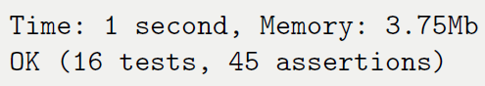
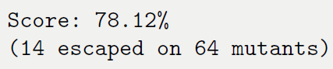
White-Box
Unit Test
Server
Code Coverage
Mutation Testing
Code Coverage vs. Mutation
32 OF 32 | 15.02.2014
Department of computer science
AALBORG UNIVERSITy

Slide 33
Conclusion
Jacob Karstensen Wortmann

Slide 34
Conclusion
The application provides relevant recipes based on ingredients
Easy to navigate
Powered by a search algorithm
Support for free-text search
User can login using Google+
Confident that the server returns correct results
31 OF 32 | 15.02.2014
Department of computer science
AALBORG UNIVERSITy

Slide 35
Future Work
Jacob Karstensen Wortmann

Slide 36
Future work
Shopping list
Start page
Recipe filters
Sharing
Recipe cache
Recipe license
Conversion
Recipe references
Settings
Scaling of recipes
Intelligent sort of ingredients
User created recipes
Localisation
Log interesting ingredient searches
Revoke Google account access
36 OF 32 | 15.02.2014
Department of computer science
AALBORG UNIVERSITy
Notes:
- The motivation for our application is to make it easy for organisers of exhibitions to enter the mobile platform. With
a website tool to ease the creation and administration.
The users will have the same application for different exhibitions, so the user will not have download different application for different exhibitions.
- We would not exclude big indoors exhibitions, so navigation should also be possible indoors.
- We also don't want to spam the users of the application, so there should also be possible to personalise the application.
- It should'nt be hard to create an exhibition and manage it.

Slide 37
Demonstration
Jacob Karstensen Wortmann

